Slide 1
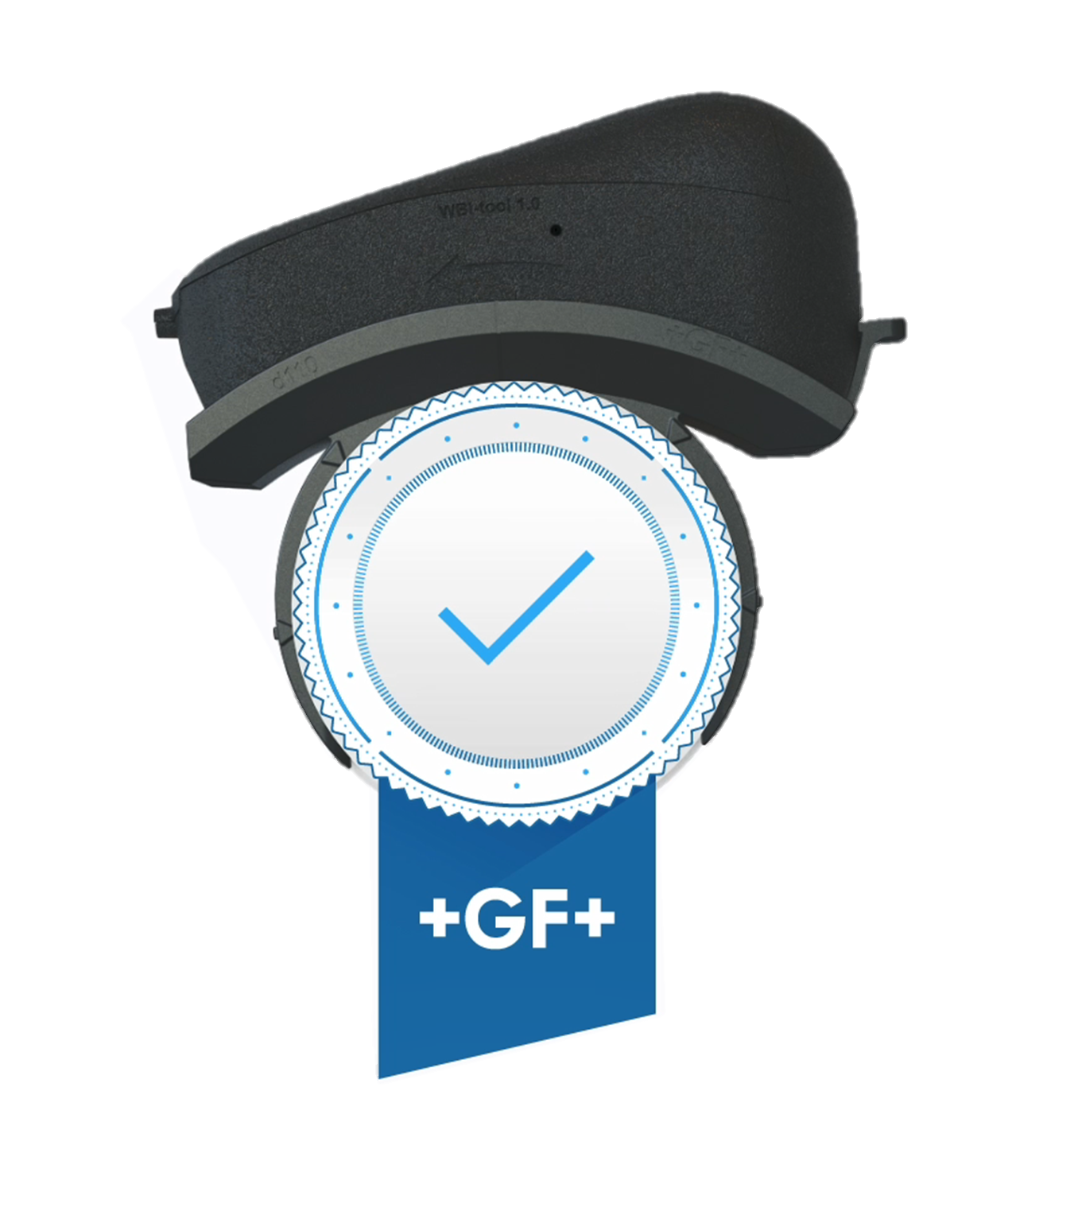
WBI Tool 1.3 Your seal of approval
GF Piping Systems

Slide 2
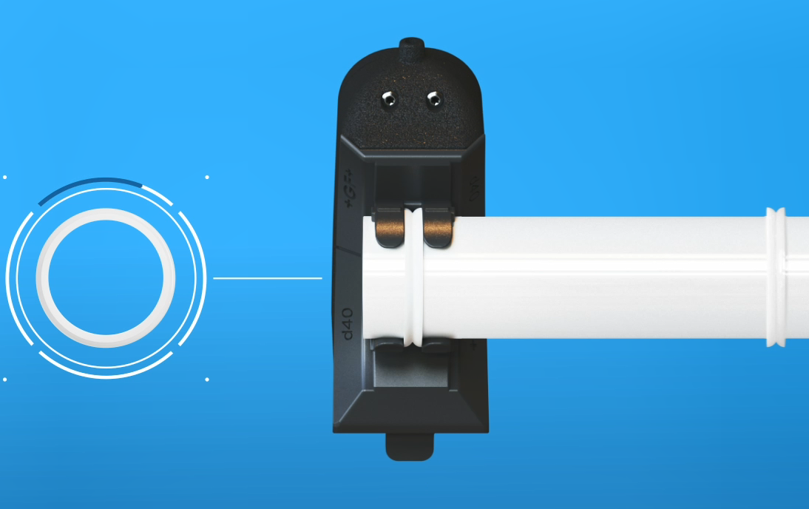
Why the WBI Tool?
WBI Tool 1.3
We have a lot of know-how and experience in weld bead inspection (WBI). However, the final judgement depends on human judgement (subjectivity). Nowadays, experienced welders and QC personnel are difficult to find.
Current GF WBI does not provide sufficient documentation of the facts.
→ WBI Tool provides objective and documented results

Slide 3
Bad welds = $ in damage
WBI Tool 1.3
…bad welds could potentially result in millions of dollars in damage

Slide 4
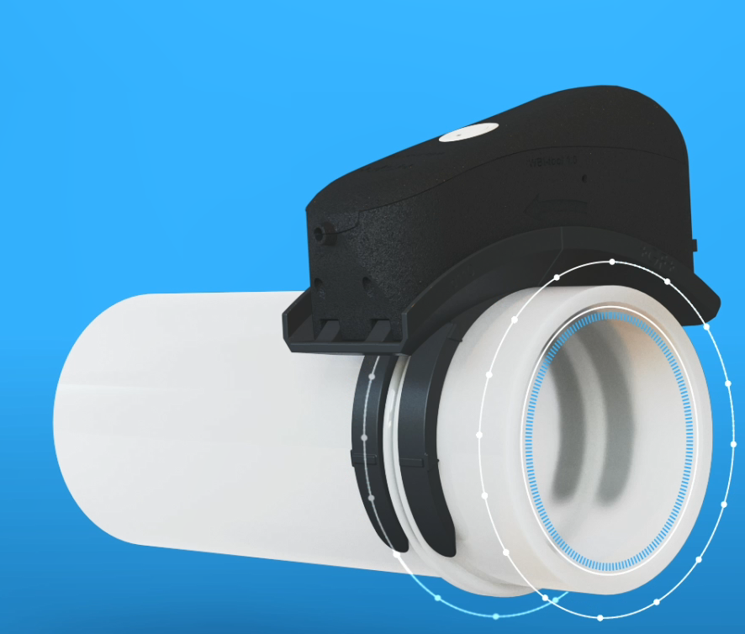
What do we cover?
WBI Tool 1.3
IR welds with GF components and machines
d20 – d225
SYGEF PVDF
PROGEF PP
SYGEF ECTFE
PE ecoFit
360° covered
4 measuring points d20-d63
8 measuring points d75-225
Measuring points can be doubled for extra safety

Slide 5
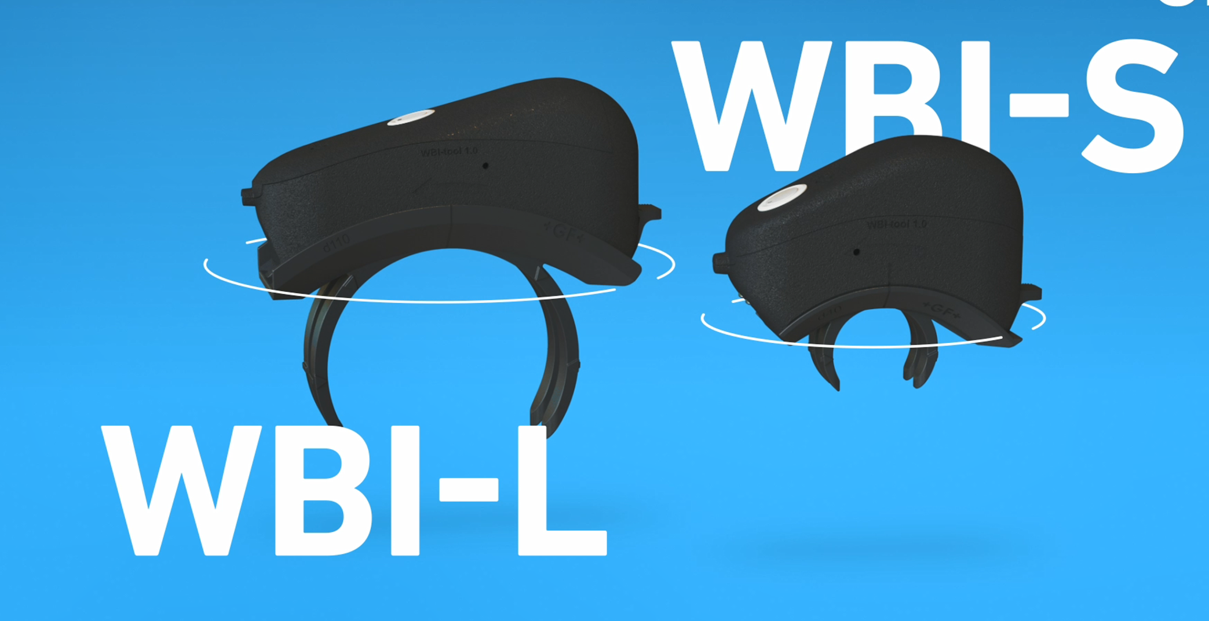
2 Tool Sets
WBI Tool 1.3
WBI Tool Set S for d20-d63: 790170001
Incl. WBI Tool S for d20-d63
WBI Tool Set L for d20-d225: 790170002
Incl. WBI Tool S for d20-d63 and WBI Tool L for d75-d225

Slide 6
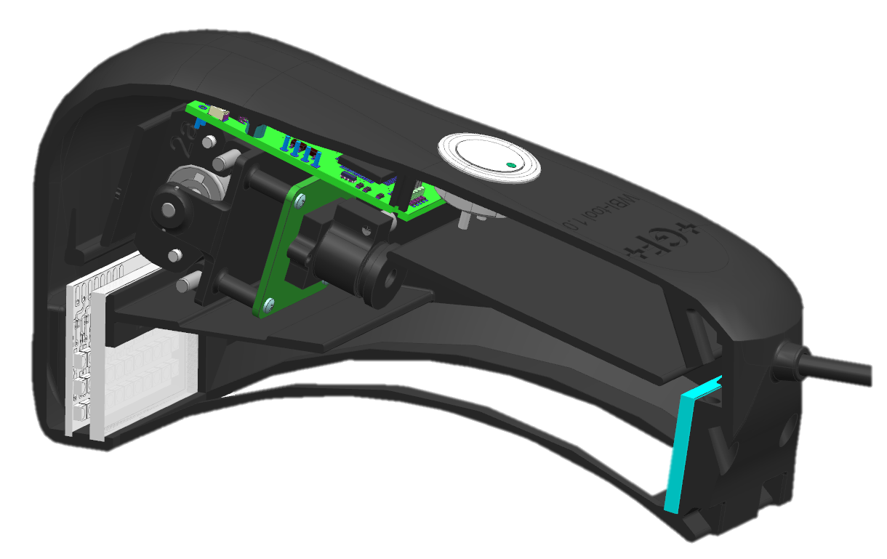
Quality you can measure
WBI Tool 1.3
Motor
Circuit board
Built by GF to the highest standards and constructed with cutting edge sustainably 3D-printed components
Light rays
Mirror
Camera
LED light
Weld bead

Slide 7
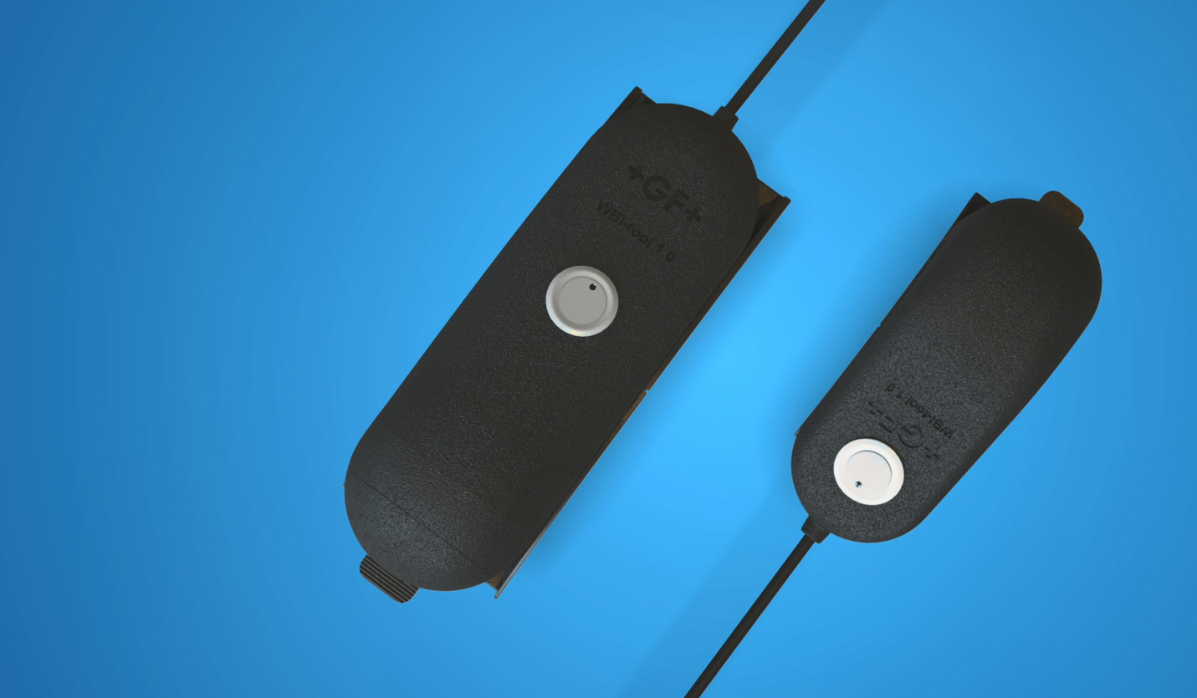
Technical details
WBI Tool 1.3
Weight WBI Tool Set Large (incl. transport case) | 22.4 kg
Weight WBI Tool Set Small (incl. transport case) | 13.5 kg
Length x width x height (transport case WBI Tool Set L) | 67x50x45 cm
Length x width x height (transport case WBI Tool Set S) | 67x50x23 cm
Electrical power supply (printer) | 100-240V 50/60 Hz
Electrical power supply (tablet) | 100-240V 50/60 Hz
Voltage WBI Tool | 5V, 3A
Working temperature range | +5°C to +40°C
Storage temperature range | +0°C to +55°C <70% relative humidity
Languages | English, Korean, Chinese simplified, traditional Chinese, Japanese, German

Slide 8
Weld bead criteria
WBI Tool 1.3
Measurements:
K-Value: > 0
Wall offset: </=10% in average
Total width
Heights
Area
Angle of components: </=8°
Not covered:
Contamination
(e.g. wrong cleaner)
Evt. overheating, damages

Slide 9
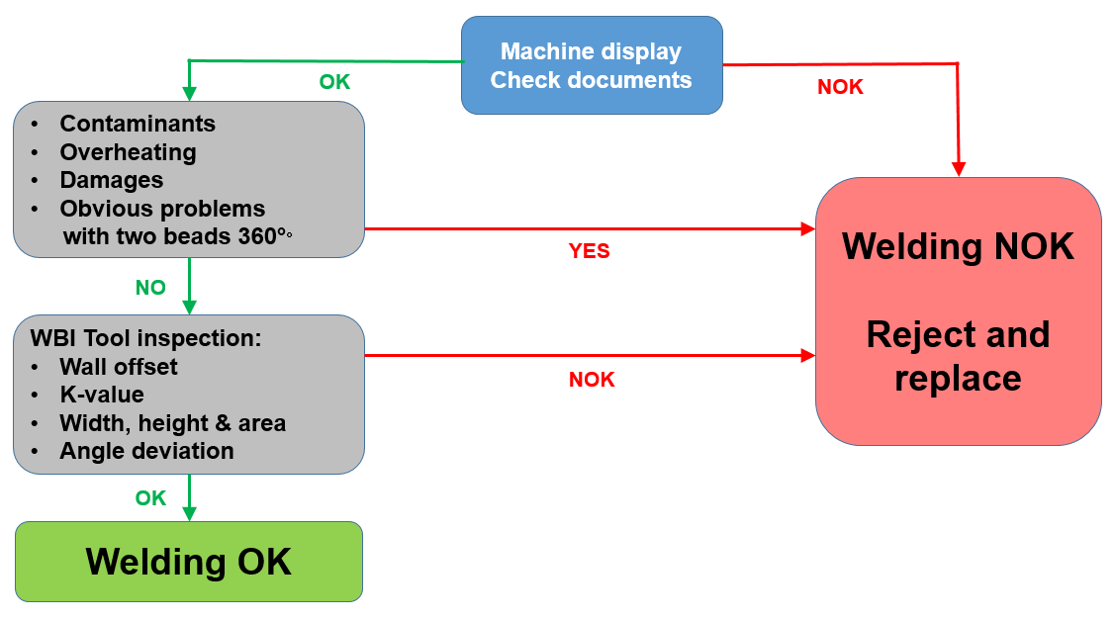
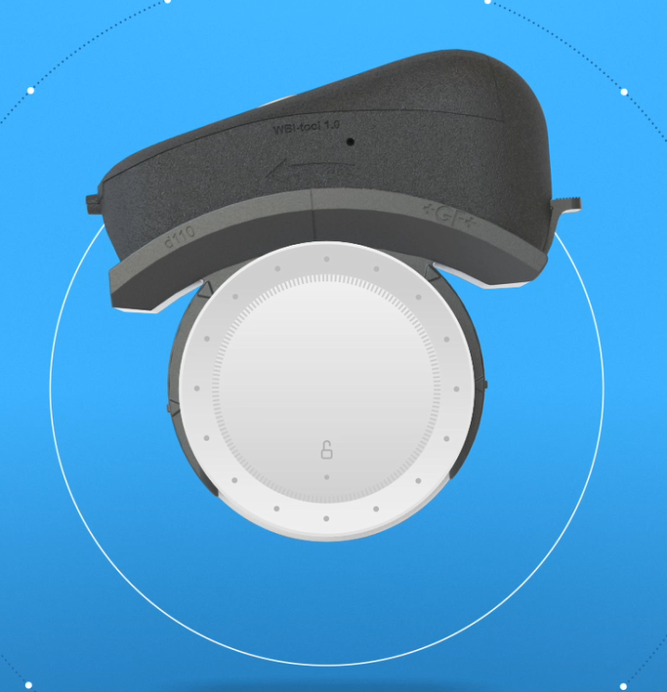
How does the WBI Tool fit in the overall WBI process
WBI Tool 1.3

Slide 10
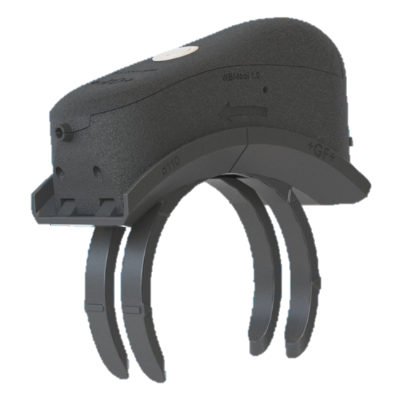
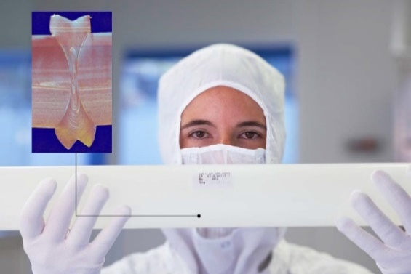
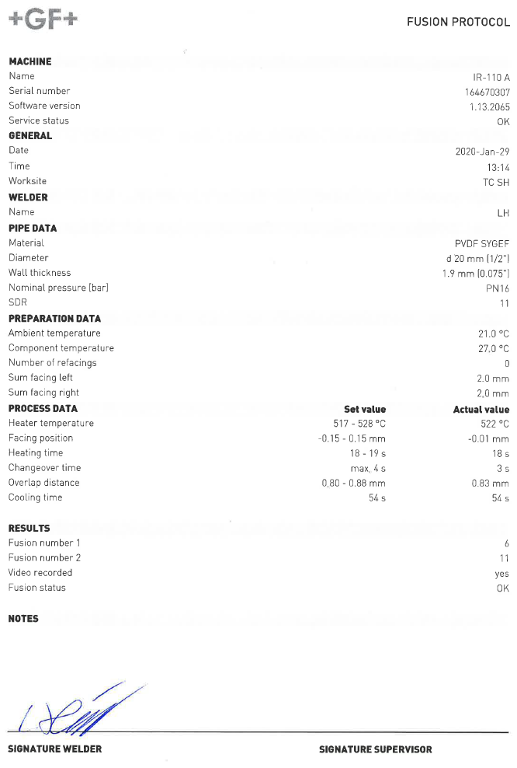
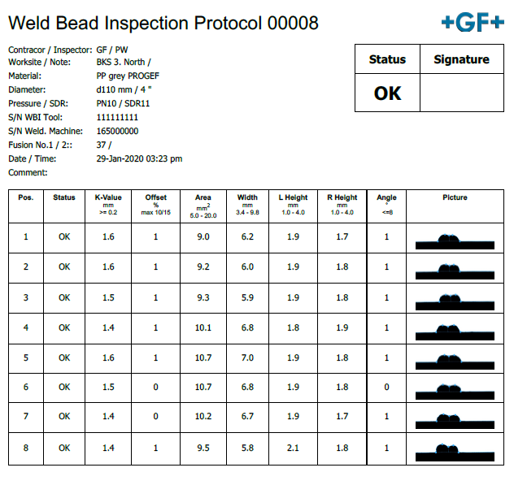
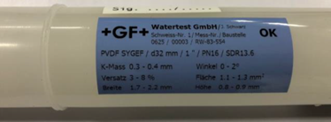
Two steps to the final decision
WBI Tool 1.2
1. Protocol of the machine + 2. Protocol of the WBI tool
and visual check
+
→ Final decision OK / NOK by welder / QA/QC manager

Slide 11
WBI Tool 1.3

Slide 12
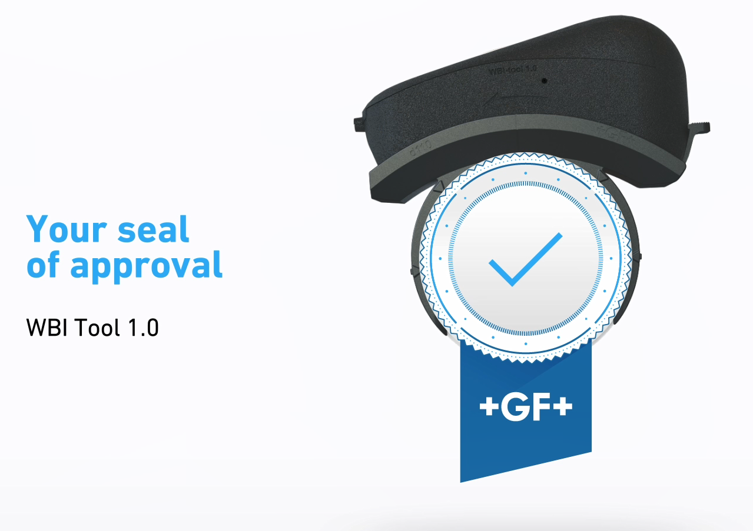
WBI Tool 1.3

